Slide 1
DO NOW
In your table of contents under the Lesson 2 section. Add the following:
Lesson 3: Do all objects change shape or bend in a collision?

Slide 2
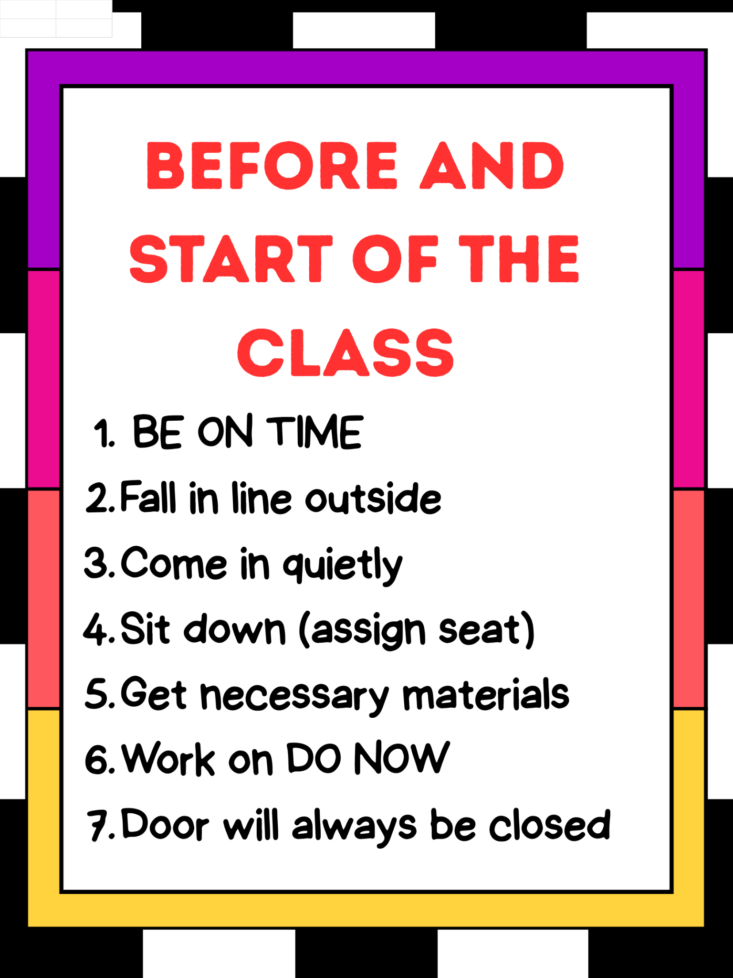
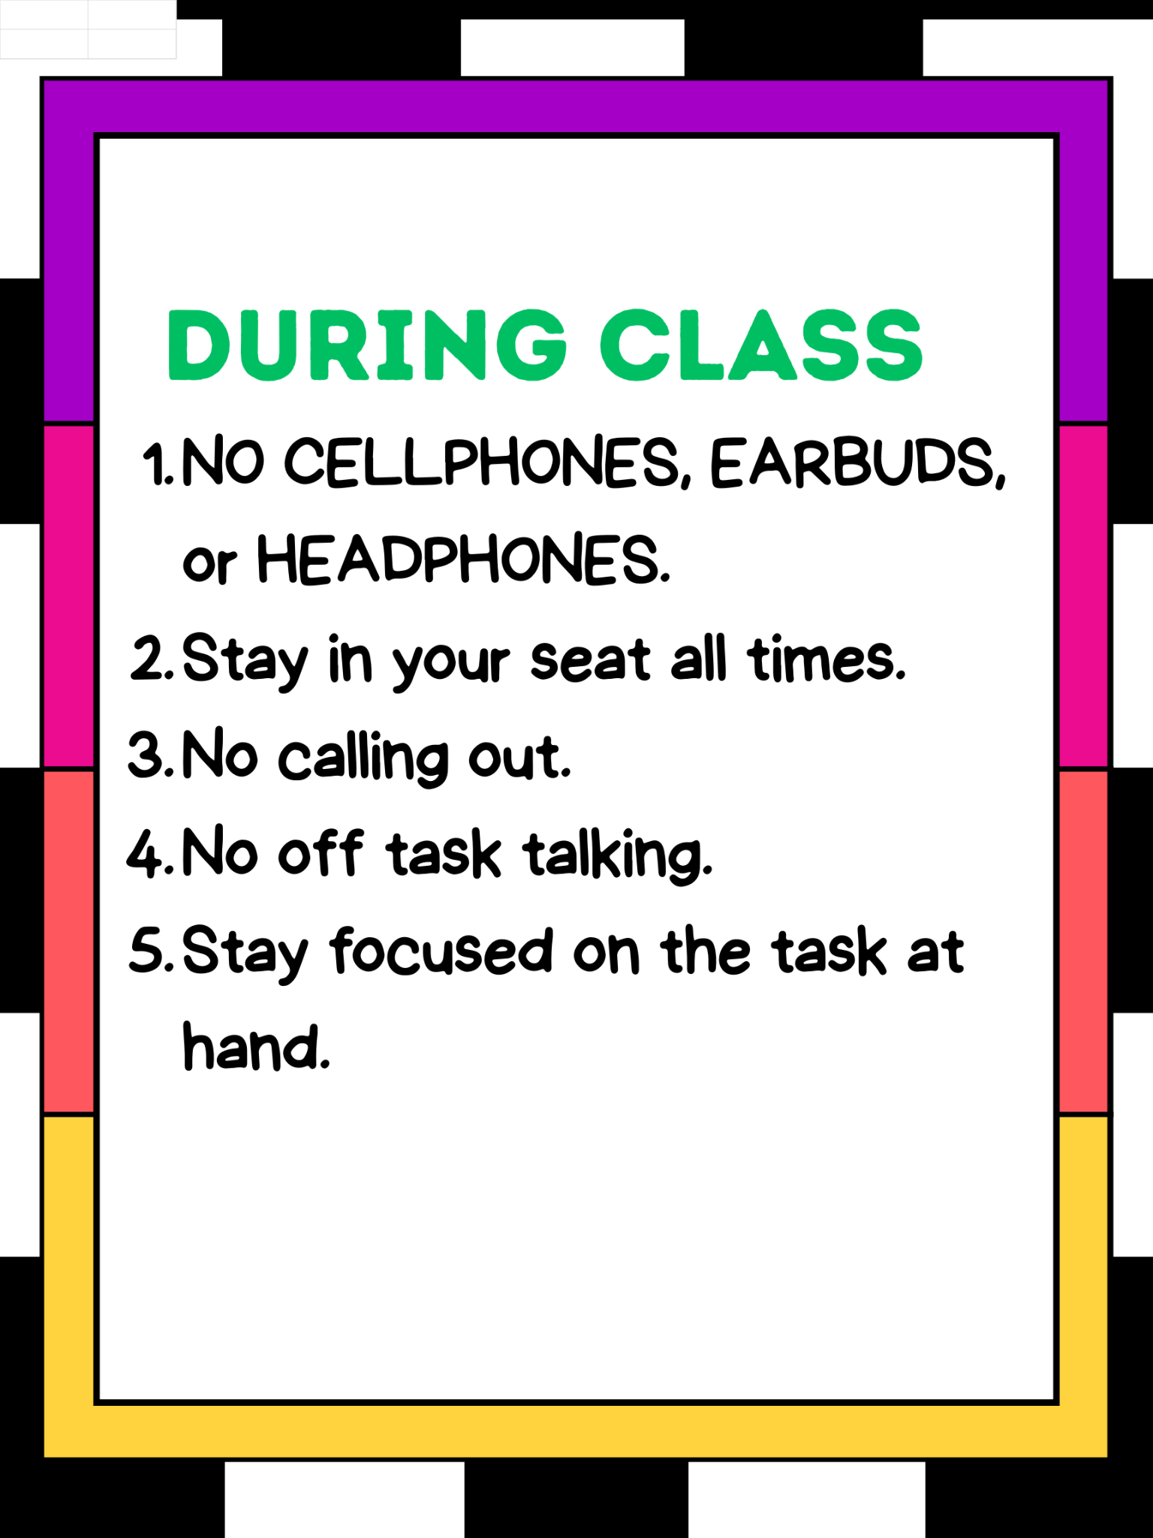
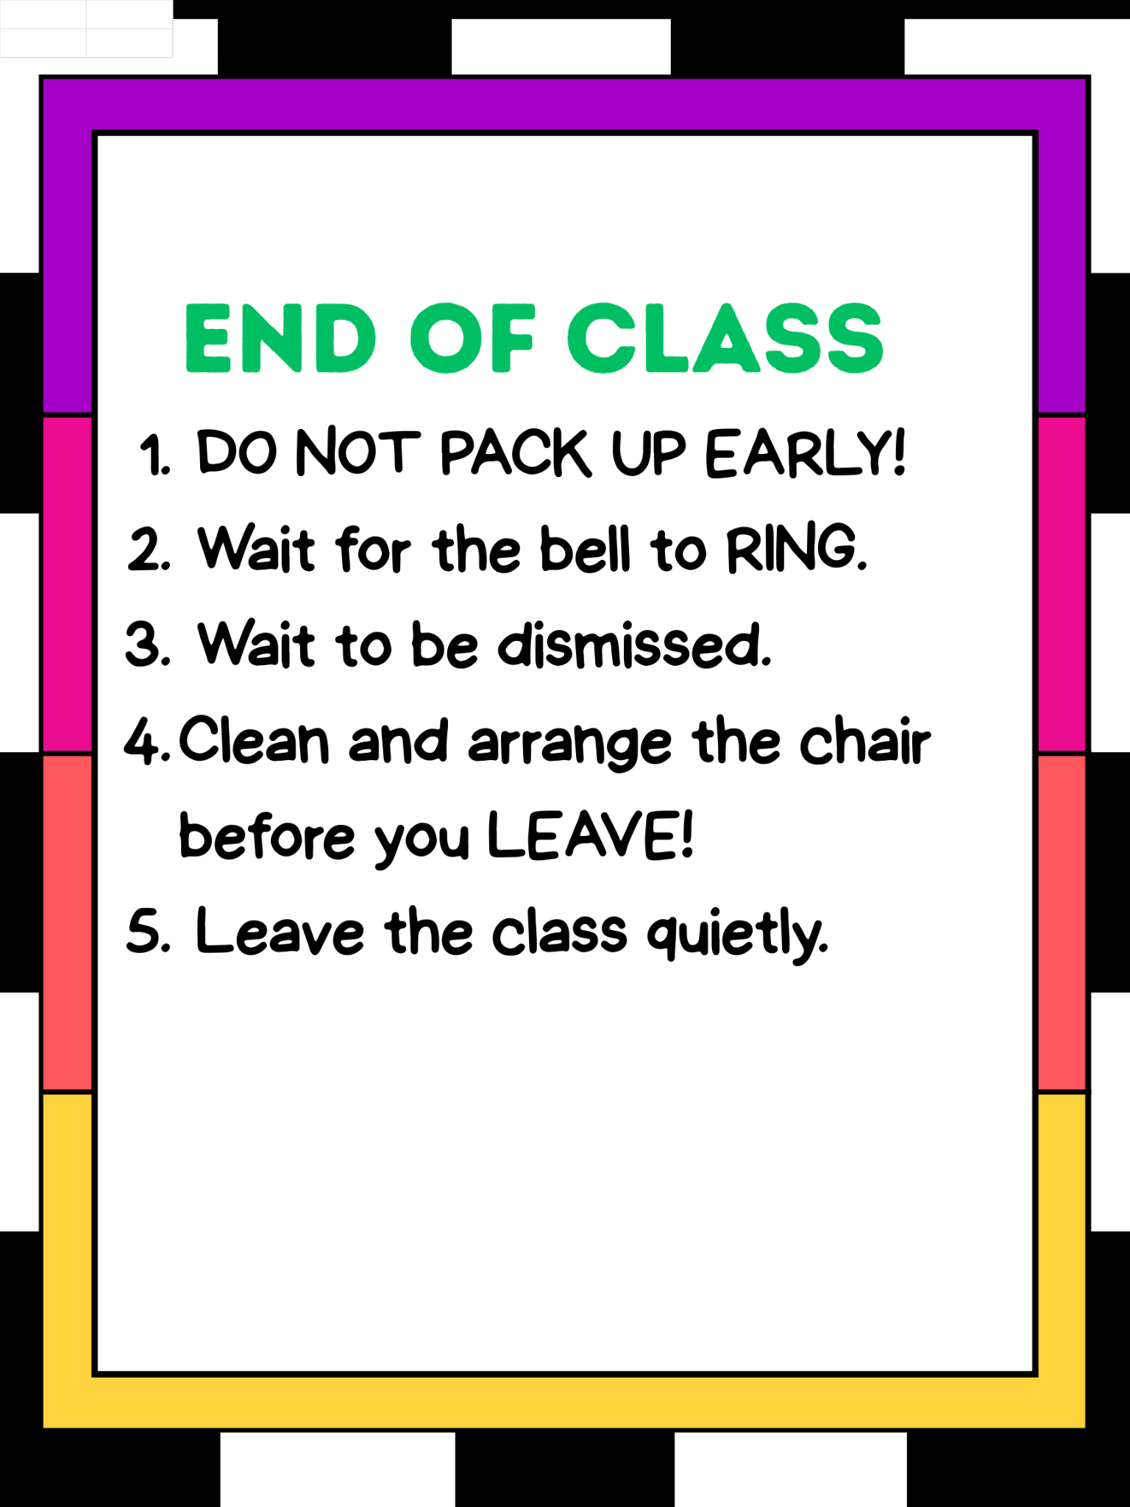
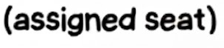
ROUTINES/EXPECTATIONS

Slide 3
I want to take a poll but most of you don’t participate. I think I know why.
Maybe you’re afraid of being wrong or you don't want to be the first one to raise your hand.
I think I have a solution

Slide 4
#1. No one here knows the correct answer so no one will know if you’re right or wrong.
#2. We’re all going to say what we think at the same time.

Slide 5




Navigation
Slide P
With Your Class
Take a poll:
Does the force from a collision always cause shape changes in the objects that collide, but sometimes we just can’t see or detect it?
YES
NO
Notes:
Consider whether shape changes happen in all collisions. Say, So we’ve seen shape changes in the collisons we’ve looked at, where slow-motion video provided the evidence we needed to see that change. And we think that forces in the collision cause this shape change. So is this something that is always happening? Do you think the force from a collision always causes shape changes in the objects that collide, but sometimes we just can’t see or detect it?
Project slide P. Take a quick poll in response to this question. Anticipate some controversy around this idea.
Say, It appears we have two competing claims in our classroom. Some of us think that all objects bend or change shape in a collision. And some of us think that not all solid objects bend or change shape in a collision. We are going to need data to support or refute either of these claims. But one challenge in trying to support or refute a claim where we are asking “does this happen in all cases” is that we can’t test all cases. So let’s brainstorm some types of objects or materials that we know are very rigid that we could test.

Slide 6

LESSON 3
Do all objects change shape or bend when they are pushed in a collision?
Contact Forces: Collisions
OpenSciEd Unit 8.1

Slide 7

Navigation
Slide A
Turn and Talk
Last lesson, we investigated shape changes in some objects during a collision using slow motion videos. Some of you may have been surprised at what we discovered.
Our investigation also led to more questions than answers.
Talk with your table about some of your questions from our collision labs and the videos we watched
Be prepared to share your ideas with the whole class.
Notes:
Recall the question we decided we needed to investigate last time. Say, Last time, we were looking at slow-motion video and noticed some surprising shape changes happening in some objects during a collision. That led us to realize we had a new question to investigate further which we took a poll on and brainstormed some ways to investigate it.
Project slide A. Give students a couple of minutes to discuss the questions on a slide with a partner and then discuss the questions as a whole class.
Say, This sounds like a lot of objects to test. And though we know we can’t test all objects in existence to answer our question, we would need to test at least some of these in order to have sufficient evidence to answer our question. Let’s get ready to do that.

Slide 8
Questions
Do all solid objects bend or change shape when they collide, even a little?
If something looks rigid, could it still bend in ways we can’t see?
What counts as evidence that an object bent?
Does the amount of force change how much things bend?
How does speed of the collision affect bending?
Does an object’s mass matter for bending?
How do different material types (metal, wood, plastic, glass, foam, etc.) compare?
Notes:
Recall the question we decided we needed to investigate last time. Say, Last time, we were looking at slow-motion video and noticed some surprising shape changes happening in some objects during a collision. That led us to realize we had a new question to investigate further which we took a poll on and brainstormed some ways to investigate it.
Project slide A. Give students a couple of minutes to discuss the questions on a slide with a partner and then discuss the questions as a whole class.
Say, This sounds like a lot of objects to test. And though we know we can’t test all objects in existence to answer our question, we would need to test at least some of these in order to have sufficient evidence to answer our question. Let’s get ready to do that.

Slide 9


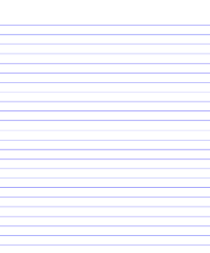
Progress Tracker
Write down 2 questions in your progress tracker.
Pick your own or mine
Section off each lesson:
Slide 0
Progress Tracker
Question
What I figured out
Sir Isaac Dripton
October 14th, 2025
Question
What I figured out
Lesson 1
Question 1
Question 2
Six-Seven
Six-Seven
Lesson 2
Question 1
Question 2
Six-Seven
Six-Seven
Notes:
Project slide O. Tell students to add the lesson question to their Progress Trackers: What causes the changes in motion and changes in shape of colliding objects? Give students time to individually update their Progress Trackers with what they’ve figured out so far.

Slide 10

Making an Initial Claim
Slide B
Make an initial claim on the top of your handout that represents your current thinking:
All solid objects do bend or change shape when pushed in a collision.
All solid objects do not bend or change shape when pushed in a collision.
My initial claim
All solid objects _________________ bend or change shape when pushed in a collision.
Notes:
Introduce the organizer and make a claim. Project slide B. Distribute Claim and Observations Organizer to students and have them add it to their notebooks. Explain that students will use Claim and Observations Organizer to record their claim as well as the data they collect from a variety of sources to help them keep track of whether their claim is supported or refuted by the evidence.
Say, We have two competing claims in our classroom. Some of us think that all solid objects bend or change shape in a collision, while others of us think that not all solid objects bend or change shape in a collision. In a moment we’ll start collecting data to serve as evidence to support or refute these two different claims. Our first source of evidence will be from three slow-motion videos of different objects colliding. As scientists, we always want to record our thinking to help us compare our findings. So let’s start recording this by filling in the blank in this initial claim section on your handout.
Guide students in completing the claim by filling in the blank with one of the following claims that they initially agree with:
All solid objects do bend or change shape when pushed in a collision
All solid objects do not bend or change shape when pushed in a collision
Say, Remember, one of our norms is that we work together to figure things out, and it is OK if we are unsure at this point. It doesn’t matter if our original claim is right or wrong, right now it is important for us to determine what evidence we need to collect in order to support or refute our claims. We can always change our claims if we need to as we gather more evidence. That’s what scientists do!

Slide 11
Slide C
Preparing to Investigate Our Claims
Claim and Observations Organizer
Data source | Observations | Does this support or refute your claim?
Slow-moving car colliding with a stationary car
Moving golf club colliding with a stationary golf ball
Moving baseball colliding with a stationary bat
The first column lists the first 3 data sources (videos).
Use the second column to record your observations.
Use the third column to record whether the related observation supports or refutes your claim.
Notes:
Project slide C. Have students look at the “Data source” column of Claim and Observations Organizer. Explain that this column has the three videos we will watch listed for them as well as additional blank rows for some other investigations we will do together. The second column is for recording observations, and the third column is for students to record if the observations they make support or refute their initial claim.

Slide 12
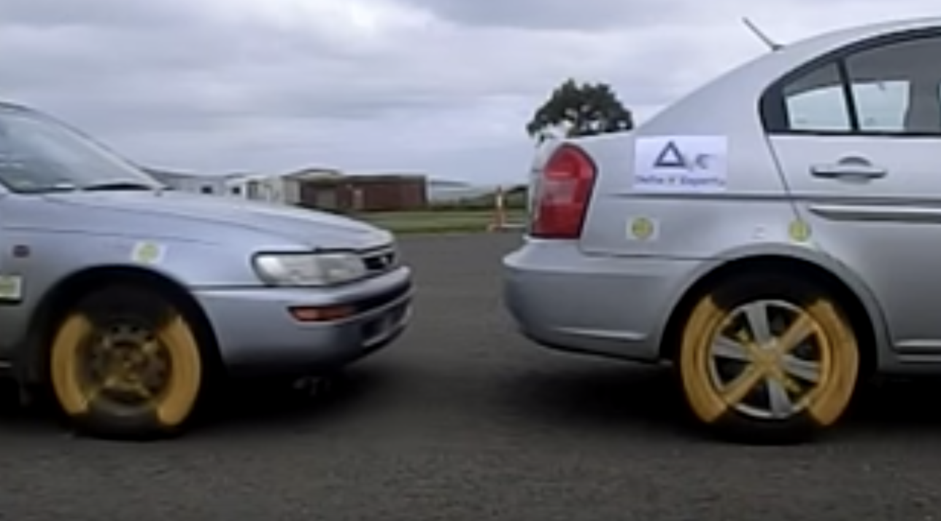
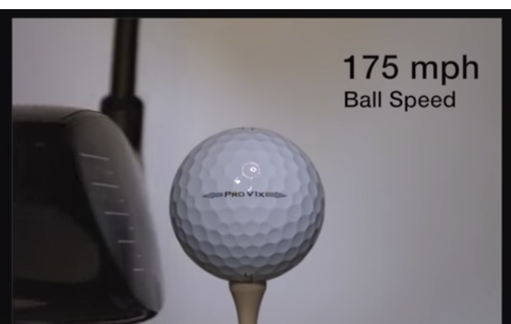
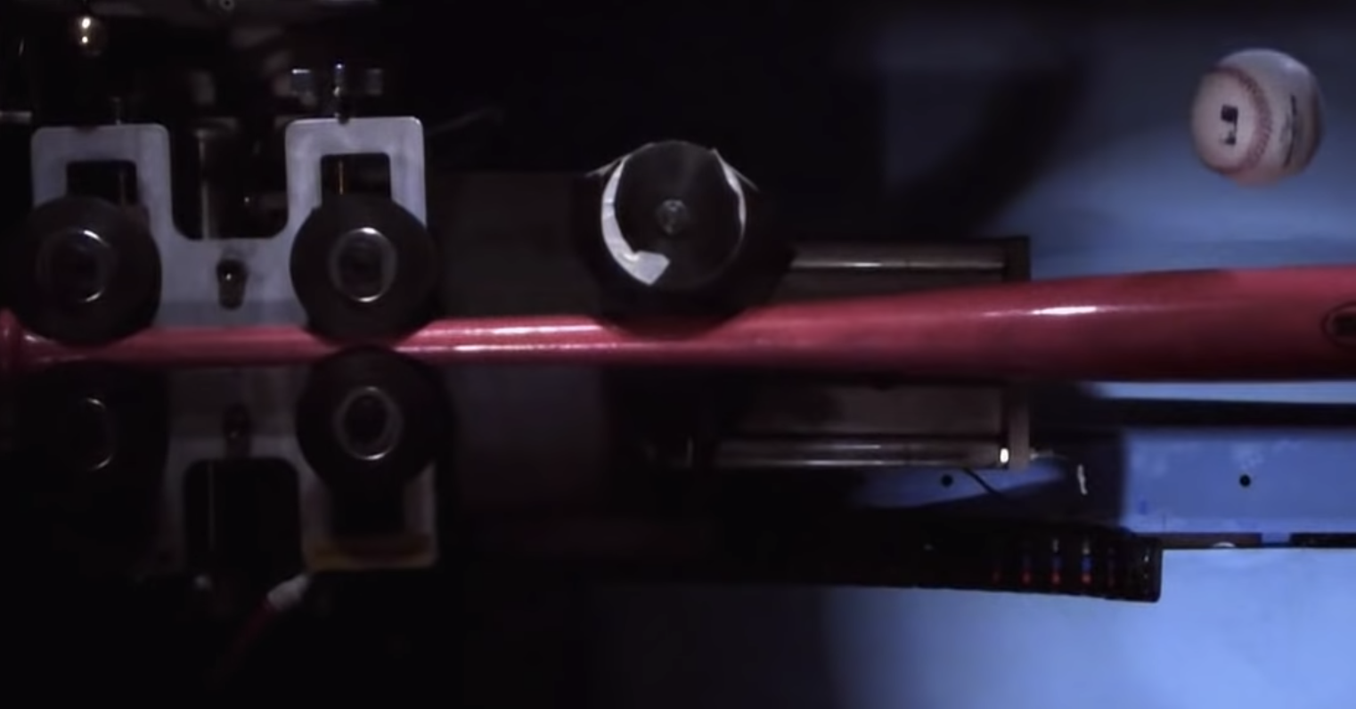
Slide D
Preparing to Investigate Our Claims
The first three data sources
Slow-moving car colliding with a stationary car
Delta-V Experts
You will see each video twice. The first time you see the clip, watch the video. The second time you watch it, record your observations.
Moving golf club colliding with a stationary
golf ball
TITLEIST
Moving baseball colliding with a stationary bat
Discovery Access
Notes:
Project slide D. Point out the three different collision video descriptions to students. Explain that each video will be played twice. The first time it is played, they should pay attention to what is occuring, but don’t record anything yet. During the second viewing they should record their observations. After viewing all the videos students will have time to decide if their observations support or refute their initial claim.

Slide 13
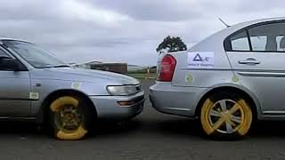
Slide E
Comparing Observations to Our Claims
Individual Observations
Video A:
Slow-moving car colliding with a motionless car
Delta-V Experts
Notes:
Play videos and record observations. Project slide E. Check that the computer sound is turned off during the playing of the videos. Play video A , which will be shown in its entirety twice. Instruct students to watch the video the first time and to record observations during the second viewing. Continue this process with slides F and G.
Show the following clips to students:
Video A https://youtu.be/My1WOu3LOCM
Video B https://youtu.be/sVr6tVy7htU
Video C: https://youtu.be/FYbn1WSWmQg

Slide 14
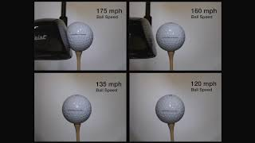
Slide F
Comparing Observations to Our Claims
Individual Observations
Video B:
Moving golf club colliding with a motionless golf ball
TITLEIST
Notes:
Show the following clips to students:
Video A https://youtu.be/My1WOu3LOCM
Video B https://youtu.be/sVr6tVy7htU
Video C: https://youtu.be/FYbn1WSWmQg

Slide 15
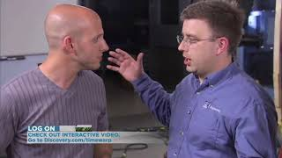
Slide G
Comparing Observations to Our Claims
Individual Observations
Video C:
Moving baseball colliding with a motionless bat
Discovery Access
Notes:
Show the following clips to students:
Video A https://youtu.be/My1WOu3LOCM
Video B https://youtu.be/sVr6tVy7htU
Video C: https://youtu.be/FYbn1WSWmQg

Slide 16
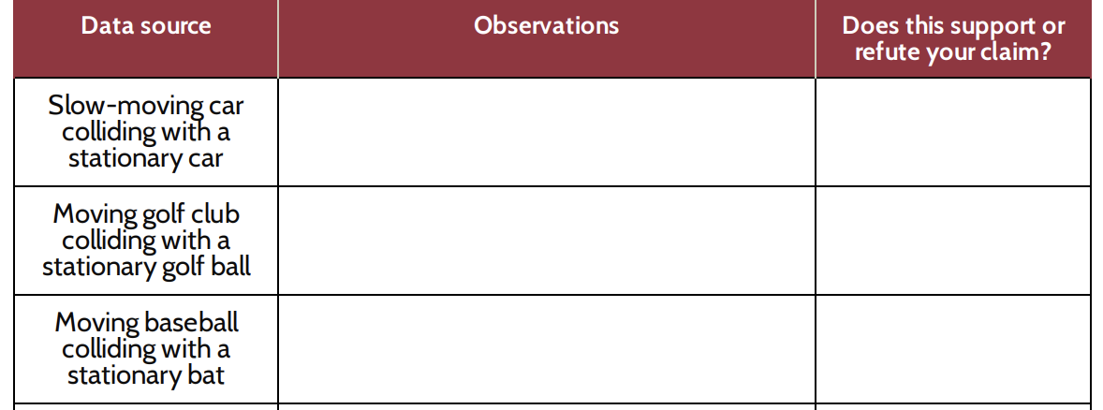
Slide H
Comparing Observations to Our Claim
Claim and Observation Organizer
Look at your “Observations” column.
Did your observations support (agree with) or refute (disagree with) your initial claim?
Write “support” or “refute” in the box in the last column.
Notes:
Project slide H. After showing the 3 videos, give students time to review their observations. Have them decide if their observations support or refute their original claim.

Slide 17

Slide I
Arguing from Evidence
Class Poll and Discussion
Let’s take a poll: Do really solid objects bend or change shape when pushed during a collision?
What is your reasoning for your answer?
Notes:
Take a poll. Display slide I. Read the poll to students.
Do really solid objects bend or change shape when pushed during a collision?
Ask students to give a thumbs up for yes or a thumbs down for no. Ask a few students to explain their reasoning, both from students who voted yes and from students who voted no.
Say, We need to resolve this question about whether all objects bend or not in a collision so that we know how this idea applies to the sort of materials like those in a collision between a glass phone screen and a concrete floor. Let’s collect some additional observations to see if we can get evidence for whether those objects bend when they get pushed on too.
Introduce the term contact force. Say, Before we move on to do that, we have been talking a lot about pushes that happen in a collision. We know from elementary school that a force is a push or a pull, and scientists have a name for the force that an object experiences due to contact with another object. It’s called a contact force. Add contact force to the Word Wall.

Slide 18
Lesson Plan & Activities
Today's Plan
Do Now
Open notebooks
Complete Thursday's handout
Claim & Observations Organizer
Review how to use the chart
Turn & Talk - Glass Breaking Predictions
Share your ideas with a partner
Glass Breaking Videos
Record observations in the organizer
Decide: support or refute your claim?
Investigating Shape Change in Concrete
Explore how shape affects materials
Rewriting Claims
Revise your initial claim using new evidence

Slide 19
Slide K
Preparing to Investigate Our Claims
Claim and Observations Organizer
Add these to your claim and organizer sheet
We will watch 2 more videos during class
Data source | Observations | Does this support or refute your claim?
Golf Ball collisions with glass (laser)
Golf ball collision with sponge (laser)
The first column lists the first 3 data sources (videos).
Use the second column to record your observations.
Use the third column to record whether the related observation supports or refutes your claim.

Slide 20
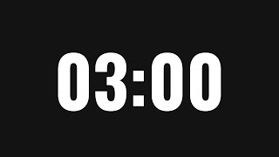
Slide J
Make Predictions
We’ve seen that pushes in a collision can cause many solid objects to bend or change shape.
Turn and Talk
If we applied a contact force to a piece of glass, do you think we would see it bend or change shape before it broke? What about thick glass?
If we applied a contact force to a piece of concrete, would you see a change in its shape before it breaks?
Be prepared to share your ideas with the whole class.
Notes:
Discuss class findings. Show slide J and read the first sentence to students. Give students a couple of minutes to read and answer the questions on the slide with a partner before eliciting responses from the class.

Slide 21
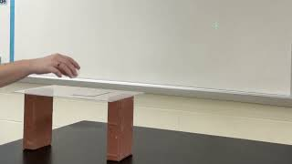
Slide K
Laser, Sponge, and Glass Investigations
Whole-Group Investigation
Add these observations to the 4th row in your data table.
Video A:
Golf Ball Collision with Glass
Laser Demo
Notes:
Introduce how the laser and mirror can detect shape changes in an object. Hold up a sponge with a piece of flexible stick on mirror material attached and then point to the top of the table at the front of the room as you say, I have a sponge. This sponge visibly bends and deforms easily when we apply a contact force. I also have a piece of glass at the front of the room. We have been wondering if our phone glass changes shape or bends in a collision, so let’s use this piece of glass to test this! It’s really hard to view this in slow motion, so I have another tool we can use to detect really small changes in the shape of an object. We are going to use a mirror and laser to magnify any time the surface of an object bends or changes shape. Let’s try it on the sponge first so we can see how it works, and then we can see if it does something similar or different with this piece of glass.
Show slide K. Have students bring their science notebooks opened to their handouts and a writing tool and gather on either side of the table at the front of the room.
The steps outlined below are demonstrated in https://youtu.be/N_LwGqvnOjk for your reference. Watch this video beforehand to see examples of all the surfaces being demonstrated. Follow similar steps when you demonstrate this equipment with students. Instruction steps with pictures can be found in the teacher guide.
Ask students to describe what happens to the reflected laser dot when you apply a force to the sponge and why. Students should say they see it move and that this is because the position or orientation of the surface of the sponge changes when the shape of the sponge changes.
Ask students whether the laser would move if you dropped something on the sponge and why. Also ask if they expect it to move if you put a weight on top of the sponge. Students will predict “yes” in both cases because both cases should cause the shape of the sponge to change.
Demonstrate how the sponge and reflected laser dot respond to these other contact forces. Direct students to write “sponge and laser” as a new data source on their handouts, directly under “moving baseball colliding with a motionless bat.”
Follow the steps outlined in the teacher guide to complete this part of the investigation.
Allow students to record observations on their handout next to the “sponge and laser” data source. Tell them not to worry about the “support or refute” column just yet--our focus at the moment is making observations.
Use the equipment to test a new system (the piece of glass). Ask students to extend what they saw to explain how this method can be used to see if glass bends or changes shape. Direct students to write in a new data source, “mirror and laser”, directly under the “sponge and laser” row.
Follow the steps outlined in the teacher guide to complete this part of the investigation.
Ask students to add a record of this set of observations on their handout.

Slide 22
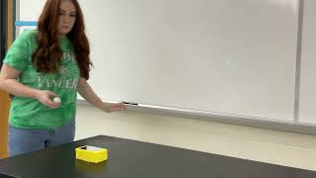
Slide K
Laser, Sponge, and Glass Investigations
Whole-Group Investigation
Add these observations to the 5th row of your data table.
Video B:
Golf Ball Collision with Sponge
Laser Demo
Notes:
Introduce how the laser and mirror can detect shape changes in an object. Hold up a sponge with a piece of flexible stick on mirror material attached and then point to the top of the table at the front of the room as you say, I have a sponge. This sponge visibly bends and deforms easily when we apply a contact force. I also have a piece of glass at the front of the room. We have been wondering if our phone glass changes shape or bends in a collision, so let’s use this piece of glass to test this! It’s really hard to view this in slow motion, so I have another tool we can use to detect really small changes in the shape of an object. We are going to use a mirror and laser to magnify any time the surface of an object bends or changes shape. Let’s try it on the sponge first so we can see how it works, and then we can see if it does something similar or different with this piece of glass.
Show slide K. Have students bring their science notebooks opened to their handouts and a writing tool and gather on either side of the table at the front of the room.
The steps outlined below are demonstrated in https://youtu.be/N_LwGqvnOjk for your reference. Watch this video beforehand to see examples of all the surfaces being demonstrated. Follow similar steps when you demonstrate this equipment with students. Instruction steps with pictures can be found in the teacher guide.
Ask students to describe what happens to the reflected laser dot when you apply a force to the sponge and why. Students should say they see it move and that this is because the position or orientation of the surface of the sponge changes when the shape of the sponge changes.
Ask students whether the laser would move if you dropped something on the sponge and why. Also ask if they expect it to move if you put a weight on top of the sponge. Students will predict “yes” in both cases because both cases should cause the shape of the sponge to change.
Demonstrate how the sponge and reflected laser dot respond to these other contact forces. Direct students to write “sponge and laser” as a new data source on their handouts, directly under “moving baseball colliding with a motionless bat.”
Follow the steps outlined in the teacher guide to complete this part of the investigation.
Allow students to record observations on their handout next to the “sponge and laser” data source. Tell them not to worry about the “support or refute” column just yet--our focus at the moment is making observations.
Use the equipment to test a new system (the piece of glass). Ask students to extend what they saw to explain how this method can be used to see if glass bends or changes shape. Direct students to write in a new data source, “mirror and laser”, directly under the “sponge and laser” row.
Follow the steps outlined in the teacher guide to complete this part of the investigation.
Ask students to add a record of this set of observations on their handout.

Slide 23
Slide L
Predictions
We saw that rigid items like glass also bend when a contact force is applied to it.
Turn and Talk
Do you think that concrete would bend before it breaks when a contact force is applied to it?
Thumbs up = I think it will bend before it breaks.
Thumbs down = I think it will break, not bend.
Class Predictions Poll
Notes:
Organize students in a semicircle around the projected slides. Project slide L. Say, We have figured out something about how glass behaves when a force is applied to it from something else making contact with it, but what about something like the floor that is made from a material like concrete?
Make predictions. Ask students the question on the slide and take a poll. Use a quick count of thumbs up and thumbs down to check student predictions. Direct students to write “concrete joint timelapse video” as our last data source on the last empty blank in the “Data source” column of their handouts.

Slide 24
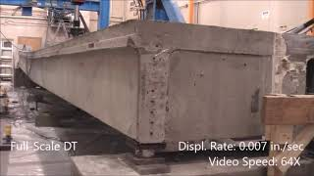
Slide M
Investigating Shape Change in Concrete
This photo shows one way that engineers test to see what will happen to an object as more force is applied.
In this video, engineers are conducting this test on a large concrete bridge joint. They increase the amount of downward force they are applying to the top of the beam to see how it will respond.
Dr. Mostafa Tazrv, Assistant Professor, Department of Civil Env. Engineering, South Dakota State University.
Image from video of Double Tee Bridge Joint at South Dakota State University
Notes:
Analyze the results from the concrete testing. Display slide M. Tell students that the images they will be analyzing were from a video of engineers testing how a concrete joint responds to different amounts of contact force applied to it. Explain that they are going to see timelapse of a video from such a test where engineers slowly increase the amount of downward force applied to the concrete joint and then observe how the joint responds. The timelapse was sped up 64x from the original speed so we can see if any changes occurred in a shorter period of observation time rather than watching the entire test in real time.
Have students look for changes in the video. Before pressing play say, As the video plays, the engineers are applying a greater amount of downward force. Watch closely so we can see if there is any change in shape associated with the force they are applying to the joint. Start the video and allow the video to play once in entirety. Ask students if they want to see any of the video again, and replay if students wish to see it a second time. Give students a chance to record their observations on their handouts.
Say, OK, we’ve seen the results from applying more and more contact force to a concrete joint. Go back now and evaluate all the data we’ve collected on the handout to determine if any of it supports or refutes your initial claim. Even if we were in disagreement at the start of the period, all the different data we analyzed should provide us adequate evidence to evaluate those initial claims and, if needed, revise them so we are all in consensus on what common claim we can now all make about our original question.

Slide 25


Slide N
Arguing from Evidence
In Your Notebook
Rewrite your original claim.
Record your answers to these questions:
Do the data support or refute your original claim?
How does the evidence from our investigations help support or refute your original claim?
Notes:
Display slide N. Have students open their notebooks to a clean page and write their initial claim. Give students time to answer the questions on slide W in their notebooks. Refer students back to their observations organizer on the handout to help them determine if the data support or refute their original claim and summarize how the evidence from our investigations helps support or refute their initial claim.
Introduce a new word. Say, We have been talking a lot about objects bending or changing shape. Scientists call this deformation. When an object bends or changes shape, it deforms.
Add deform to the Word Wall.

Slide 26
Slide P
Predictions
Take Another Poll
Do you think that the concrete beam began to deform with a small amount of contact force at the start of the test or did it take a lot more force to start bending it?
Let’s take a poll--give a thumbs up or down.
Thumbs up = It started bending with a small amount of contact force.
Thumbs down = It didn’t start bending with a small amount of contact force to it; it needed more force before it started bending.
Notes:
Display slide P to gather results on the poll for this question:
Do you think that the concrete joint began to deform with a small amount of contact force at the start of the test or did it take a lot more force to start bending it?
Have students give a thumbs up if they think it started bending with a small amount of contact force applied to it and give a thumbs down if they think it didn’t start bending with a small amount of contact force applied to it and it needed more force before it started bending.
Say, We have seen how a sponge, a piece of glass, and a concrete joint behave when a force is applied to them. Let’s consider how all objects respond to any amount of forces applied to them, since ultimately we want to explain what happens in all collisions that causes objects to get damaged in some cases but not others.

Slide 27
Slide Q
Predictions
Turn and Talk
Do you think applying any amount of force to any solid object would cause it to bend?
How could we design an investigation like the engineers did with the concrete beam test to figure out if any amount of force would cause any solid object to start bending or change shape?
Be prepared to share your ideas with the class.
Notes:
Make predictions. Show slide Q. Have students discuss the two questions on the slide with a partner:
Do you think applying any amount of force to any solid object would cause it to bend?
How could we design an investigation like the engineers did with the concrete joint test to figure out if any amount of force would cause any solid object to start bending or change shape?
After discussing these questions, say, I am interested in hearing what you all think. Let’s plan to share the ideas you discussed with your partner and also make a plan to investigate your ideas further in our next class.

